Slide 1
Nuclear Security at Major Public Events: Lessons Learned from the 2015 Pope Francis visit to Uganda
Evans Olaka OGWAL, MSc-Nuc, CNSP –Nuclear Power Program, Security and non- proliferation advisor, office of the senior presidential advisor on special operations

Slide 2
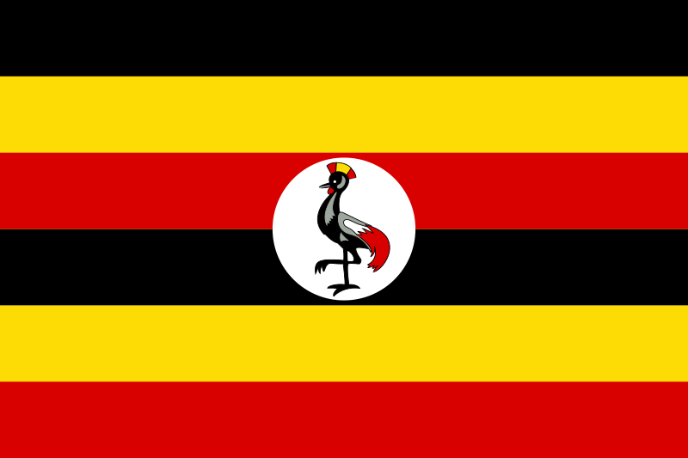
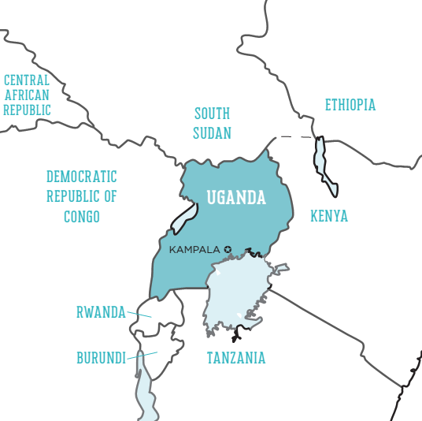
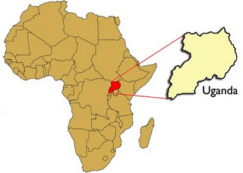
Brief of Uganda
Uganda is a landlocked country in East Africa
Capital: Kampala
President: Yoweri K. Museveni
Currency: Ugandan shilling
Population: 42.86 million (2017) World Bank

Slide 3
Security Incidences
1990s
Allied Democratic Front, a terrorist organization based in the Democratic Republic of the Congo
bombs into taxis and public buildings
50 people were killed and more than 160 were injured

Slide 4
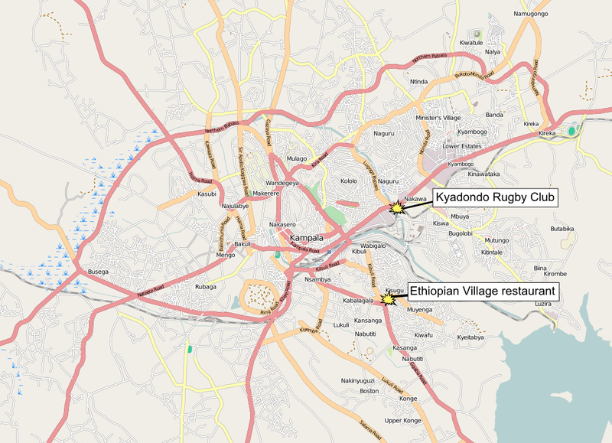
SECURITY INCIDENTS- 2010 FIFA WORLD CUP FINAL.
Deaths by nationality

Slide 5
SECURITY INCIDENTS- 2010 FIFA WORLD CUP FINAL.
Deaths by nationality
first bombing
The second attack
Kyadondo Rugby Club in Nakawa
Victims – Ugandans, 49 people DEAD
A third unexploded vest was later found
Ethiopian Village, situated in the Kabalagala neighborhood,
Victims- foreigners, 15 people DEAD.
targeting expatriates.

Slide 6
SECURITY INCIDENTS- 2010 FIFA WORLD CUP FINAL.
Deaths by nationality
Country | Number
Uganda | 62
Eritrea | 6
Ethiopia | 1
Ireland | 1
Kenya | 1
Sri Lanka | 1
India | 1
United States | 1
Total | 74
Perpetrators –
The Al Shabbab militant group
74 injured

Slide 7
UGANDA attributes the highest priority to security issues NLT nuclear and radiological security
Before and after the Pope Francis visit in 2015 to Uganda, there was a clear need for a nuclear security program in Uganda to prevent, detect and respond to the threat of nuclear terrorism.
cooperation started between the International Atomic Energy Agency, the United States Department of Energy, USNRC and a number of Ugandan Authorities under the coordination of the Atomic Energy Council Uganda.

Slide 8
Before
comprehensive programme adopted
multi-area coverage in nuclear and radiological security
physical protection of nuclear and radiological materials and facilities;
the prevention of smuggling of radioactive materials through borders;
the prevention of dispersion of radioactive materials into venues to visited;
the enhancement of emergency preparedness and response to radiation incidents, and;
the extensive training of security personnel from organizations involved in radiological and nuclear security

Slide 9
Before
comprehensive plan was put in place by the special forces command of the ministry of defense and the atomic energy council to address chemical, biological, radiological and nuclear (CBRN)threats
cooperation started in February 2013-2015, when Atomic Energy Council (AEC) proposed collaboration between the International Atomic Energy Agency (IAEA) and the Uganda Government in the field of nuclear safety and security, with the view to ensure a high level of radiological protection during Pope Francis visit in 2015.

Slide 10
Major project counterparts
International Atomic Energy Agency (IAEA),
United States Department of Energy (U.S. DoE)
United States Nuclear Regulatory Commission (U.S.NRC)
Various National Organizations in Uganda;
AEC had the coordination and the overall responsibility for the completion and sustainability of the project

Slide 11
AEC Profile
Functions of Council.
to define the exposures of ionizing radiation;
issue authorizations and grant exemptions for the possession and use of radiation sources;
define the detailed obligations;
conduct inspections to assess radiation safety and security conditions
to enforce
ensure that corrective action is taken
ensure proper documentation
systematic safety reassessment or periodic safety review
prescribe and collect fees
advice other governmental authorities and organizations
assist in emergency responses
initiate, recommend or provide support
maintain contact for information exchange and cooperation
establish appropriate mechanisms to inform the public
monitor and appraise radiation workers, the public and the environment
ensure proper collection and dissemination of information
perform any other function

Slide 12
AEC Profile
Key Areas of Interest
Radiological and nuclear security.
Emergency response and preparedness.
Radiological and nuclear security during major public events.
Illicit trafficking of radiological or nuclear materials.

Slide 13
Nuclear Security Project during the Pope Francis Visit 2015
Planning process
official agreements between the partners were signed;
significant national funding were devoted;
continuous technical and scientific support and training were planned
Chemical, Biological, Radiological and Nuclear Mitigation Procedures and plans were also considered

Slide 14
Nuclear Security Project during the Pope Francis Visit 2015 Contd,
multi-level and area coverage to leave no gaps in nuclear and radiological security was adopted
full-scale approach to nuclear and radiological security was implemented

Slide 15
INSSP Meeting

Slide 16
INSSP Meeting Recommendations

Slide 17
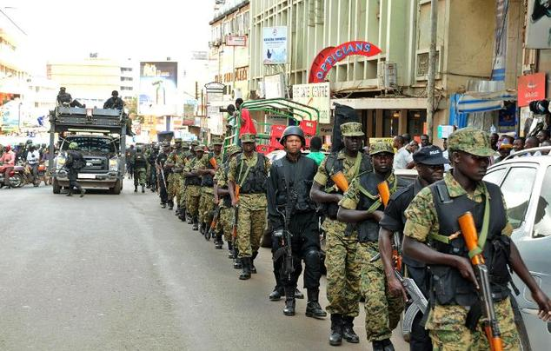
Key stakeholder

Slide 18
Preparation level one: Search and Secure Project
physical protection of nuclear and radiological materials and facilities in order to prevent the theft or sabotage of radioactive materials, already been used or stored
Search and secure project, coordinated by AEC with USDoE:
started in 2010 aiming in the collection of unused radioactive sources in the country
training on Search & Secure of Orphan sources in Uganda at Amber House from 18/2/2015 to 19/2/2015. The objective of the training was to prepare technical officers to locate, identify, package, transport, and secure orphan radioactive sources.

Slide 19
Preparation Level one: Inventorization Project
on 7/5/2015 United States Nuclear Regulatory Commission (USNRC)-Radiation Sources Regulatory Partnership (RSRP) to reviewed the Inventorization project and assess the progress of the registration of radiation sources in Uganda.
The Uganda Radioactive Materials Database was established, Updated- Software and platform provided by USNRC

Slide 20
Commonly regulated practices in Uganda-Preparation Level one: Search and Secure Project

Slide 21
Commonly regulated practices in Uganda-Preparation Level one: Search and Secure Project
High activity sources especially radiotherapy sources (Co-60 and Cs- 137) have been collected and stored. In the same framework, the national waste management facility at Mpoma, Central Uganda is being constructed with significant upgrades.

Slide 22
Preparation level one: US-DOE Radiological Threat Reduction programme
Under the, the physical protection of radiological materials in Uganda was enhanced. In particular, the physical protection systems of radiological installations in 02 hospitals (Mulago and Lacor Referral Hospitals) housing the old depleted and new Co-60 sources were strengthened.
Construction of a new depleted source storage facility with perimeter detection system, the installation of new CCTV system, new main and backup lighting schemes and a new security control room

Slide 23
Preparation Level Two-prevention: illiciting trafficking of radioactive materials.
AEC in collaboration with the IAEA and the Uganda Revenue Authority Customs Office, Conducted a national Training for Customs officials
New technology was applied at borders to detect illicit trafficking of radioactive/nuclear materials.
1 portal monitor at Busia Boarder and 31 pieces of handheld equipment were provided in 2 cargo and passengers entry points of the country,
The fixed systems back scatter detectors.
hand held equipment used for the secondary control
These sets of equipment are composed by radiation pagers indicating the presence of radiation, gamma detectors in order to determine the radioactive source location and intensity and spectrometers specifying additionally the radionuclide.

Slide 24
Nuclear Security Project during the Pope Francis Visit 2015 Contd,
Preparation Level Three: Goal- preventing the dispersion of radioactive materials into an shrine venue.
radiation detection at the shrines was performed prior and during the Popes Francis Visit
Radiation search to find hidden strong sources in the shrines, including the around the popes residence, had been performed several days prior, continuously and also before starting the shrine tour, using specialized equipment (large volume NaI portable spectrometer, plastic scintillation detectors, radioisotope identification devices, radiation pager alarms).
measurement results were used as background signals for the surveys followed during the tours

Slide 25
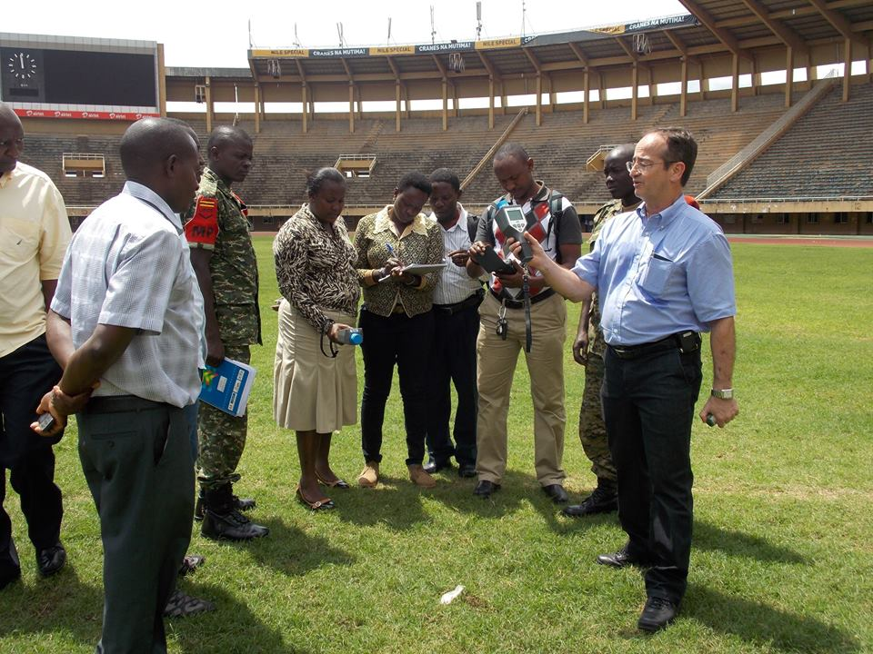
All key stakeholders

Slide 26
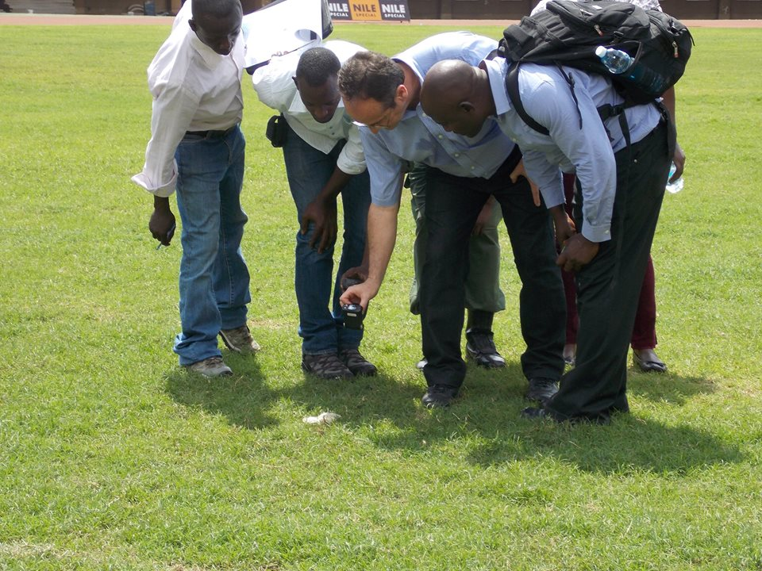

Slide 27
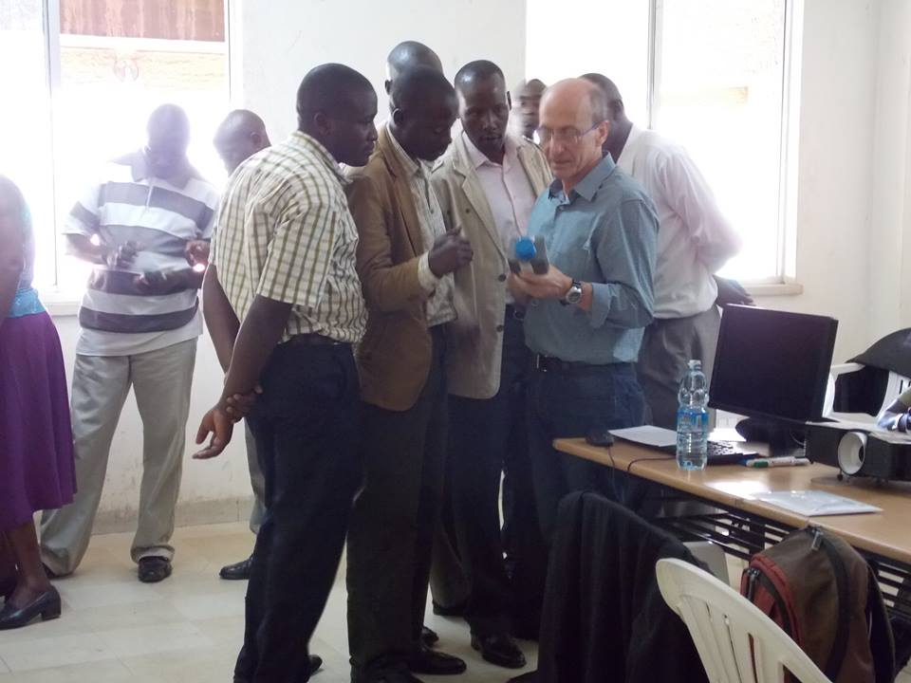

Slide 28
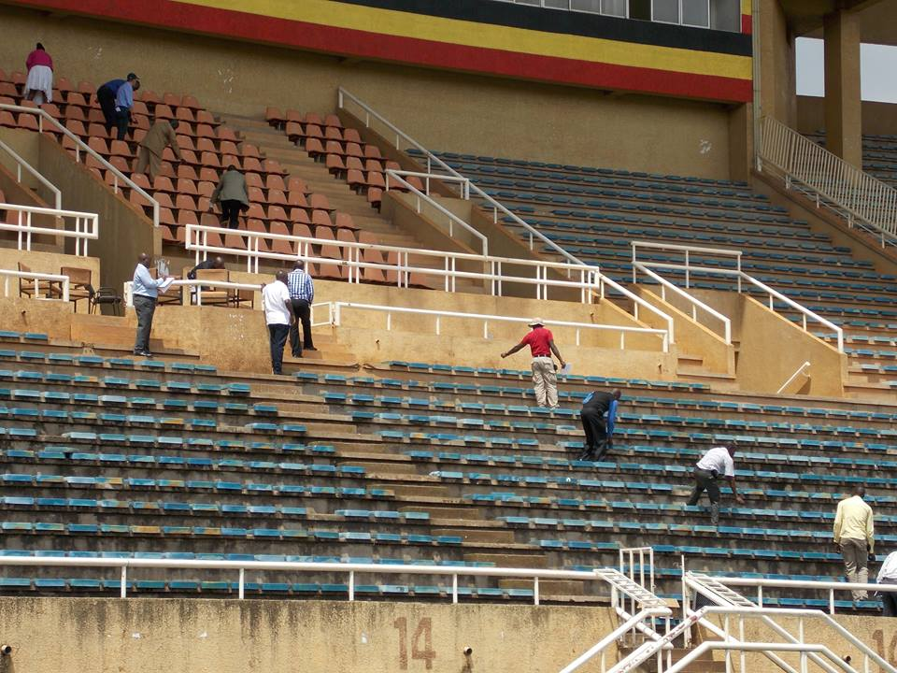

Slide 29
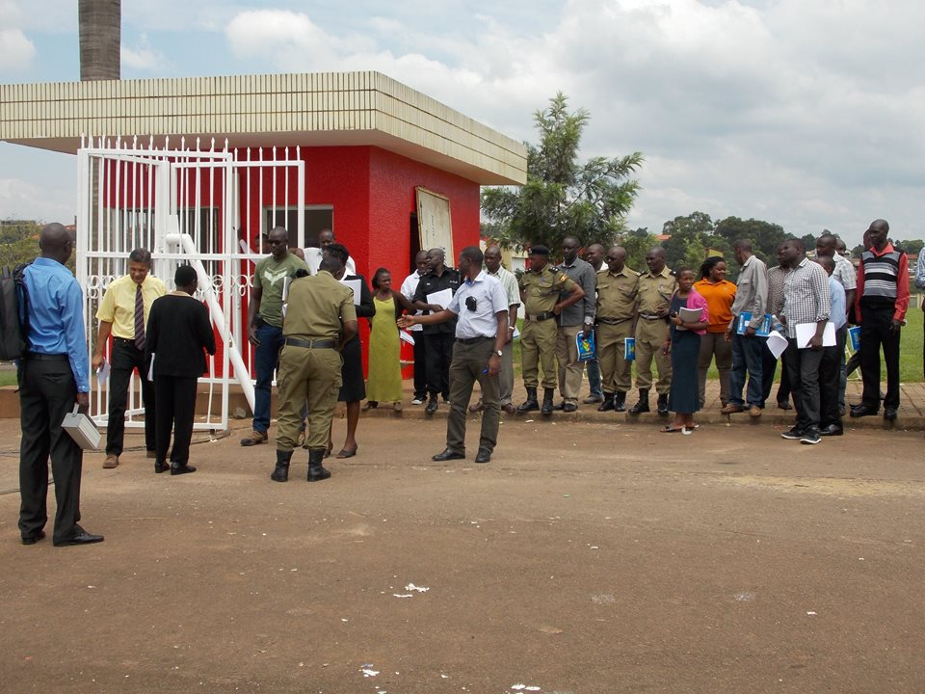

Slide 30
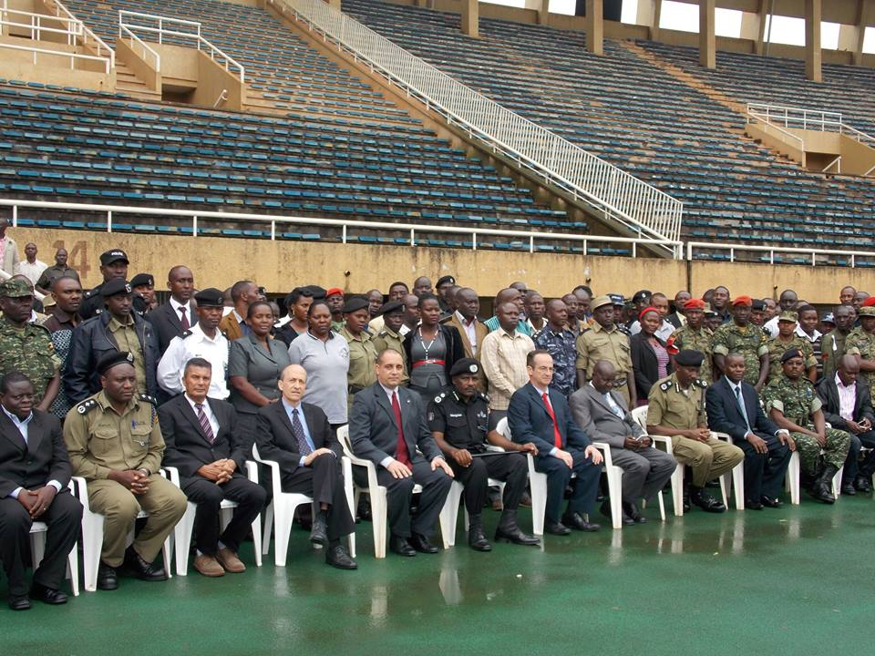

Slide 31
Nuclear Security Project during the Pope Francis Visit 2015 Contd,
Preparation Level Three: Goal- preventing the dispersion of radioactive materials into an shrine venue.
Radiation detection at the entry points of the shrines was performed continuously.
placing permanently radiation pagers next to the metal detectors at the gates of the venues,
providing radiation pagers or personal radiation detectors to the security officers. Several detectors and identification systems were used.
Security officers were assisted by AEC scientific staff.
innocent alarms that happened were by people who had undergone treatment-specific entry allowance issued to such persons.

Slide 34
Nuclear Security Project during the Pope Francis Visit 2015 Contd,
Preparation Level Four: Radiological Emergency Preparedness and Response
AEC role:
Developing and preparing a national emergency preparedness and response plan;
ensuring that arrangements are in place for a timely, managed, controlled, coordinated and effective response at the scene and at the local, regional, national and international level, to any nuclear and radiological emergency; and
preparing and periodically reviewing emergency preparedness, response action levels and intervention levels
The Atomic Energy Council, through the Radiological Emergency Response Committee (RERC) is the point of contact for national preparedness and response to radiological safety and security related events.

Slide 35
Nuclear Security Project during the Pope Francis Visit 2015 Contd,
Radiological Emergency Preparedness and Response.
Radiological Emergency Response Committee (RERC)
Section 57-62 of the Atomic Energy Act No. 24 of 2008, provides procedures for the establishment of National Radiological Emergency Response Committee (NRERC), its functions and the relevant stakeholders, responsibilities of the operators during Emergency situations and the general components of emergency response plans
Under the IAEA Project RAF/9047: “Strengthening and Harmonizing National Capabilities for Response to Radiation Emergencies in the Member States”.

Slide 36
Nuclear Security Project during the Pope Francis Visit 2015 Contd,
Radiological Emergency Response Committee (RERC)
Composition:
The CEO –AEC and a representative from each of the following :
The Ministry responsible for Health,
Ministry responsible for Information,
Ministry responsible for Disaster Preparedness,
National Environment Management Authority;
Uganda People’s Defence Forces;
Uganda Police Force;
The Uganda Prisons Service and;
the International Committee of the Red Cross.

Slide 37
Nuclear Security Project during the Pope Francis Visit 2015 Contd,
Activities
Continued with Radiological Emergency Preparedness and Response program;
Developed Radiological Emergency Preparedness and Response program
Trained radiology/medical officers on clinical management of radiation injury
Designate d a medical centre for the management of radiation injuries
Designated an Radiological Emergency Mobile van
Designated a centre and run Emergency Response Drills.
“Technical assistance was sought from the IAEA to help the committee draw a general National Action Plan and action plan for the pope Francis visit.”

Slide 38
Nuclear Security Project during the Pope Francis Visit 2015 Contd,
scientists from IAEA visited AEC and provided advices and recommendation for the upgrade of its emergency response systems. Their activities included
Infrastructure upgrading: Provision, collection, checking, calibration
Classification of: -Measuring and detection systems
Protective equipment.
Independent communication system
Documentation of all the procedures step by step, followed in case of an emergency.
Training and exercises.

Slide 39
IAEA Expert visit
The Uganda's National Emergency Coordination and Operations Centre (NECOC) mobile Unit

Slide 40
Nuclear Security Project during the Pope Francis Visit 2015 Contd,
Co-operation: Emergency Response Systems and Data Bases (IAEA Illicit trafficking data base)
6 national organizations have been established. Extensive cooperation in the area of intelligence between the partners helped the radiological emergency system become more efficient and effective
Staff participation in several committees, working groups, meetings, exercises and visits related to emergency response and planning

Slide 41
Nuclear Security Project during the Pope Francis Visit 2015 Contd,
Training:
creation of a mechanism for persons involved in this project are trained to pursue their duties effectively,
Experts from IAEA, CBRNe provided training in emergency response issues to the AEC (Centre for the dissemination of Response knowledge). • Customs personnel were trained in 2015. • Organization or participation in training programmes responsible for response including the fire brigade, the Civil Aviation Authority, the Special Forces Command, custom officers, the radiological facilities, the network of associated laboratories,first responders, the medical physicists and the medical personnel of the main hospitals.

Slide 42
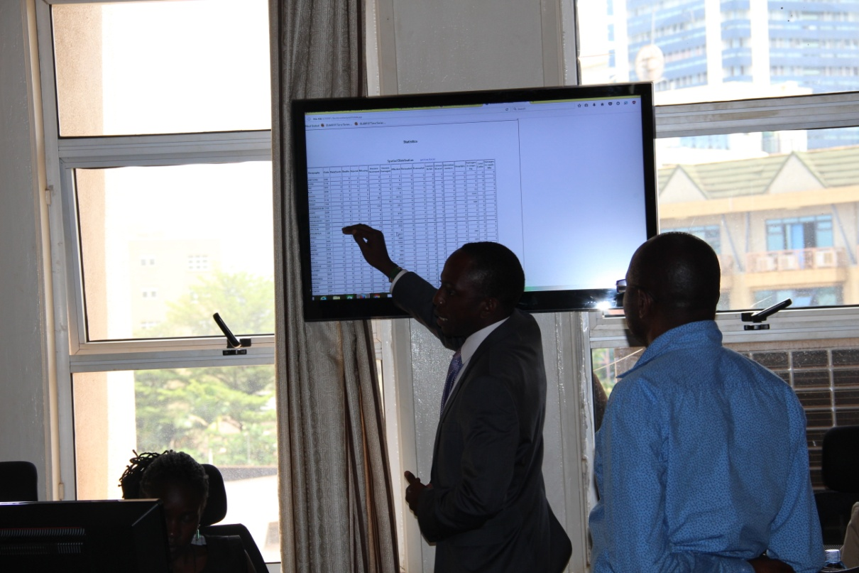
Training of coordination team

Slide 43
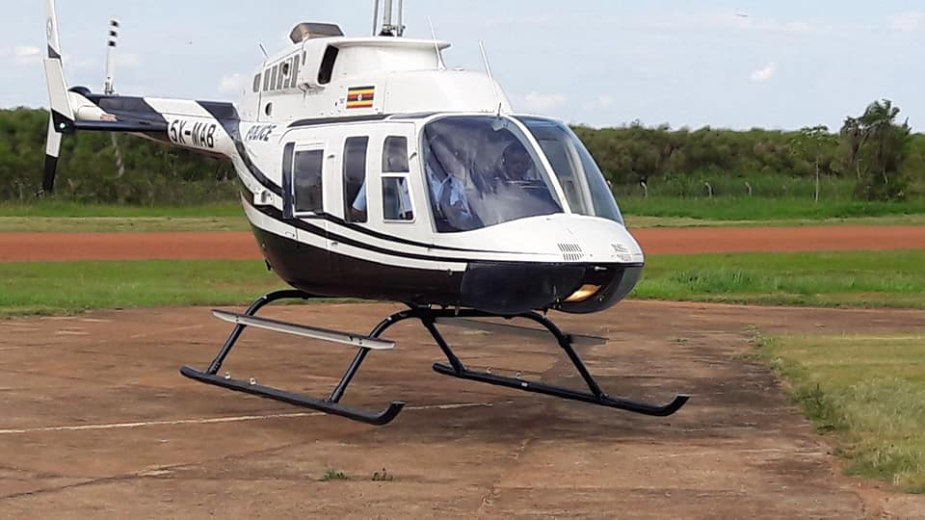
Response Team

Slide 44
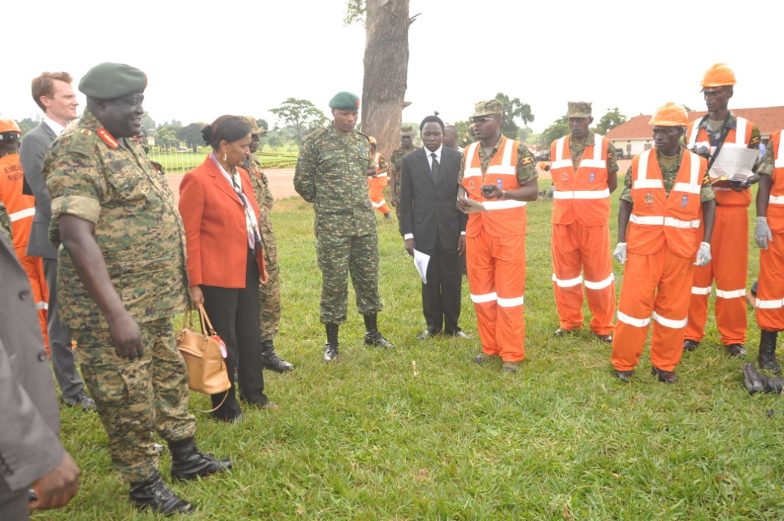
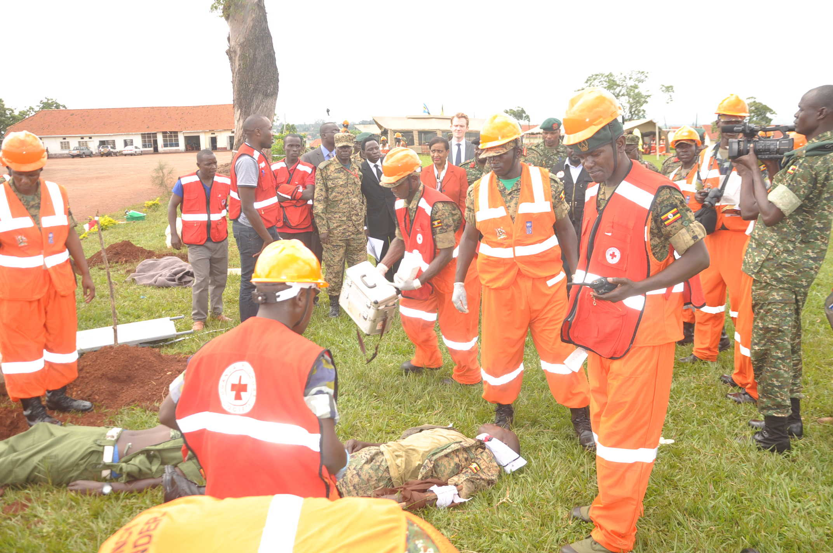
Training of Military First responders

Slide 45
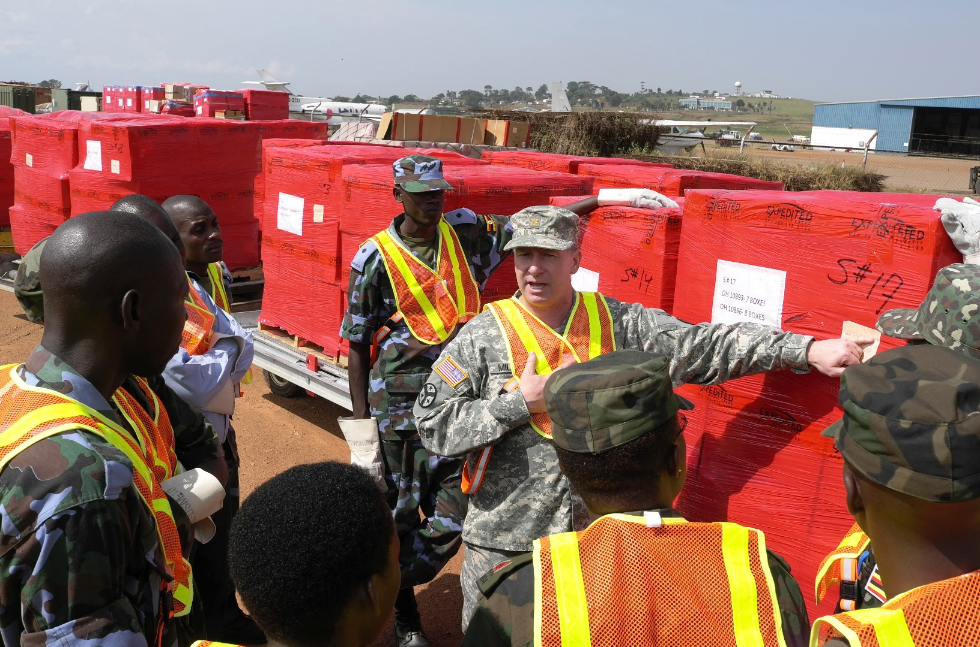

Slide 46
Nuclear Security Project during the Pope Francis Visit 2015 Contd,
Sustainability:
The Ugandan Government contributed to the program significant national funds. All Authorities involved have the appropriate personnel and technical infrastructure to support the program.
The AEC contributed/s with its know-how to ensure smooth operation of the systems.
AEC undertakes the responsibility of the continuous training of the custom officers, law enforcement officers and first responders, of the provision of additional equipment to various authorities and institutions, as well as of the maintenance of the equipment used in customs and the calibration of all radiation detectors.

Slide 47
Lessons Learned- Organizational Level
It is majorly the psychological and economic impact and not the massive loss of life from the dispersion of radiological materials are that requires emergency measures for nuclear security.
Close coordination and cooperation between all partners is critical.
Strong political leadership from a lead agency in the host country.
International and locale expertise must be combined in the design and implementation the project.
The combined threat (radiological, chemical and/or biological) should be accounted for in the emergency planning and response, as well as in training.
The existence of adequate, trained and well informed personnel with clear assignment of responsibilities is a prerequisite especially knowledge dissemination.

Slide 48
Lessons Learned- Organizational Level Contd
Time is a crucial factor for all activities (planning, contract negotiations, purchase/acquisition of equipment, acceptance tests, installation, training, etc).
Introducing or implementing structural changes in the facilities/procedures, well informed personnel must be involved with their opinion seriously considered.
It is a near-term event , plan for long-term use and benefits of the systems (plan for the sustainability) ,transition of full ownership and operation to the host country, equipment use after the event must be redistributed and/or leasing.
illicit trafficking information (IAEA ) important for evaluation of the general terrorist threat to the events especially when there is limited time available for decision-making.

Slide 49
Lessons Learned- Technical Level
During major events, both the threat level and the consequences of threat activity may be significantly higher than the norm. For that reason, the adequacy of the security systems, should be reassessed.
special emphasis must be attributed, in order to ensure the functionality of the system during the installation of physical protection systems in radiological installations (operation of both access control and alarm systems is challenging for proper execution of duties of the staff ).
Potential adverse consequences of threat sabotage are reduced by shutting down critical installations during the major event. Through the past and present bilateral agreements from the critical installation, the neighboring countries assisted broadly to enhanced border security , and sharing their own experiences.

Slide 50
Lessons Learned- Technical Level Contd
In preventing and handling false and innocent alarms and their possible consequences quick localization of person at the check point, not in the crowd is key.
Integrate standard security equipment with radiation detection equipment.
The optimally position radiation detectors in the entrance of the venues (one pager at the belt of the security officer, and one pager under the tray), considering X-ray and electromagnetic interferences.
Catalogue NORM spectra for the region to limit delay detection of anomalies.

Slide 51
Lessons Learned- Training
Initial training /refresher training is necessary to ensure that the system works.
Cooperative teamwork (experts with different background contribute to the project).
Create a comprehensive, phased plan taking into account different stages, different categories of staff (specialty, tasks, etc).
Provide timely and convincingly information to address concerns on radiation, chemical and biological agents.
Provide theoretical and practical training on radiation, instrument usage and procedures, scheduled well in advance
Proper and timely availability of documentation. Adherence to established plans and processes (equipment, procedures, training facilities, materials, trainers and trainees).
Exercises demonstrating the cooperation of different authorities, based on a national response plan and small-scale exercises for the personnel within a single authority. Include instrument training materials into the purchase

Slide 52
Conclusion
The Pope Francis visit to Uganda was successful and peaceful with no significant nuclear security incidents earning a proposal for Pope Francis to visit Uganda again in 2019. its imperative for other states to learn from Uganda and from member states that have hosted major events and persons since their experience serves as a model for nuclear security for major public events.
Assistances is available for countries in their efforts to secure major public events in the future.

Slide 53
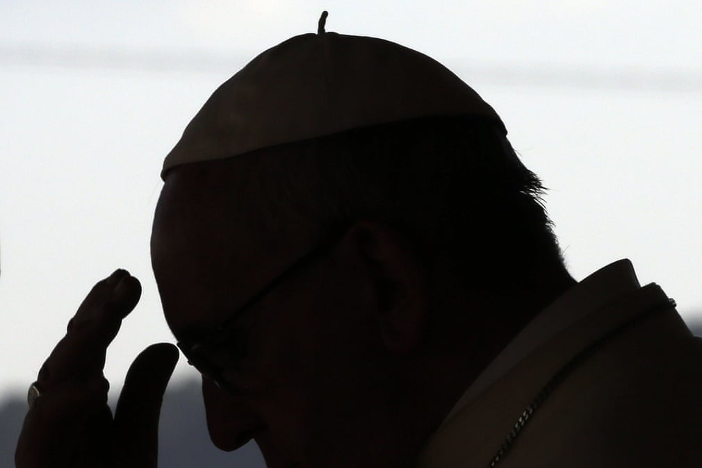
Apwoyo
Webaale
Thank you

